Slide 1
Flight Delay Analysis
Akshay Kalmetar (10525530)
Jishnu Vattakattil (10522789)
Shandilya Sutar (10526703)
Srikanth Tangirala (10522903)

Slide 2
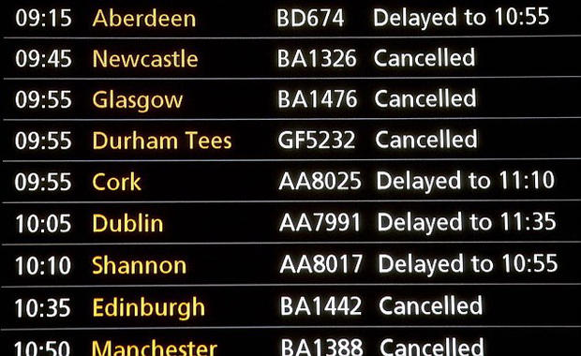
Did this ever happen to You?

Slide 3
Introduction
In USA , the Federal Aviation Administration estimates a lose of $22 Billion yearly.
The airline company are held responsible for this delay and are forced to pay if airline has to hold the flights for more than three hours for the domestic flight or more than four hours for Outbound flights.
Flight delays causes difficulties for the passengers as well.
This problem can have a solution if we can predict the flight delays.

Slide 4
Objective
To find and understand the factors causing flight delays.
To get visuals of Airlines on-time, Cancelled and Diverted Flights

Slide 5
Dataset
Title : Flight Delay Analysis
Source: https://www.transtats.bts.gov/Fields.asp
Description: Bureau Of Transportation Statistics keeps track of On Time performance of domestic flights operated by large air carriers. Summary information on the number of on-time, delayed, cancelled and diverted flights appears in this data.
Number of rows:754989
Number of Variables: 30

Slide 6
Variable Description
Name | Description
Year | 2018
Month | 1-12
DayofMonth | 1-31
DayOfWeek | 1(Monday)- 7(Sunday)
DepTime | Actual departure time
CRSDepTime | Scheduled departure time
ArrTime | Actual arrival Time
CRSArrTime | Scheduled arrival time
UniqueCarrier | Unique Carrier Code
FlightNum | Flight Number
TailNum | Plane Tail Number
ActualElapsedTime | In minutes
CRSElapsedTime | In minutes

Slide 7
Variable Description(continued)
Name | Description
AirTime | In minutes
ArrDelay | Arrival delay, in minutes
DepDelay | Departure delay, in minutes
Origin | Origin IATA airport code
Dest | Destination IATA airport code
Distance | In miles
TaxiIn | Taxi in time, in minutes
TaxiOut | Taxi out time, in minutes
Cancelled | Was the flight cancelled?
CancellationCode | Reason for cancellation(A=carrier, B=weather, C=NAS, D=Security)
Diverted | 1= yes ,0=No
CarrierDelay | In minutes
WeatherDelay | In minutes
NASDelay | In minutes
SecurityDelay | In minutes
LateAircraftDelay | In minutes
Status | Delayed, non Delayed

Slide 8
Schema

Slide 9
Schema Description
The star schema diagram contains 6 dimensional tables and 1 fact table.
There are 6 primary keys in the Dimensional Tables. i.e. CalendarKey, AirlineKey, OriginAirportKey, DestAirportKey, ArrivalKey, DepartureKey.
The dimensional tables are connected to the Fact table by above primary keys.

Slide 10
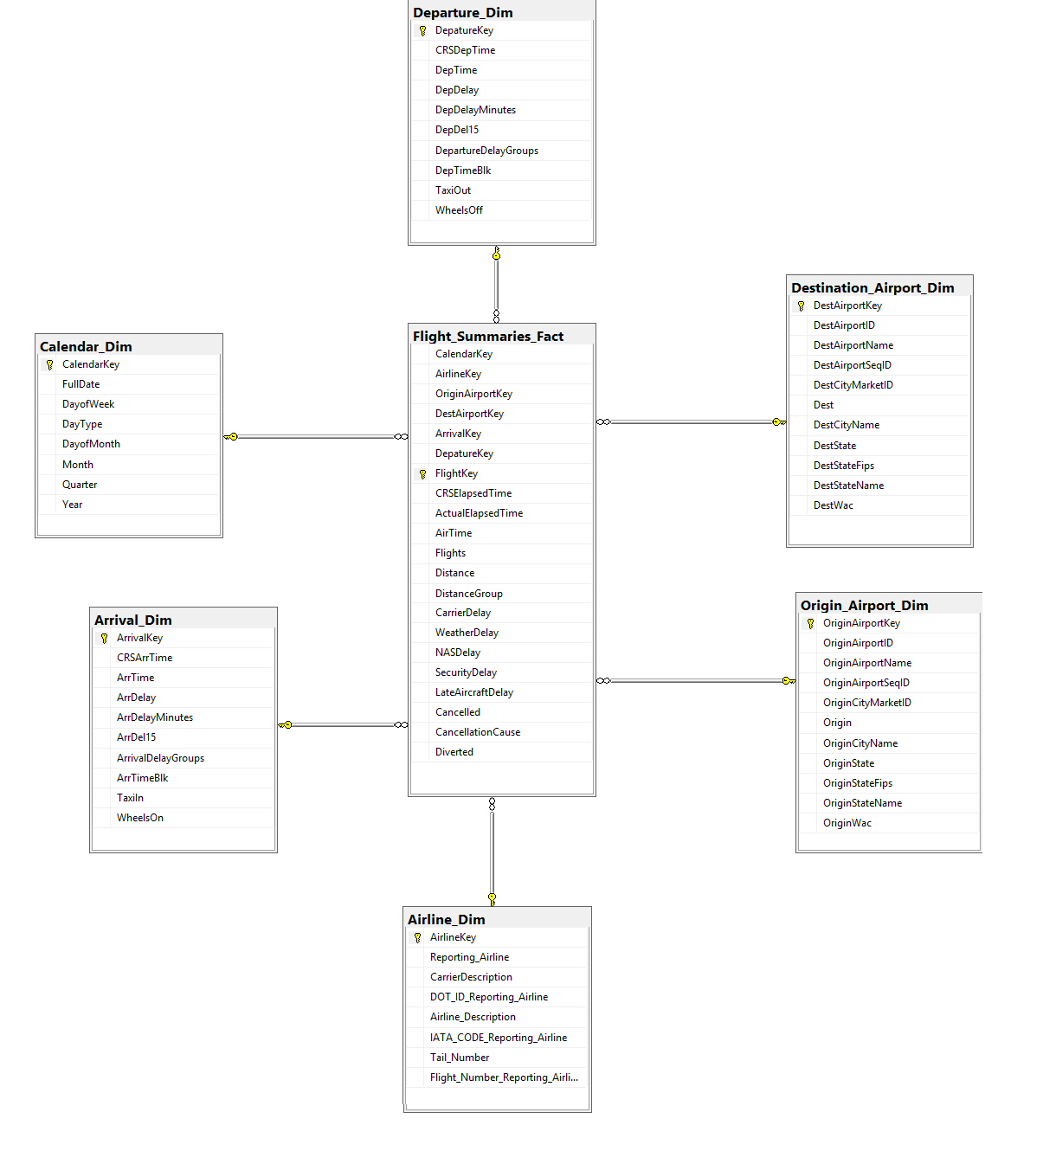

Slide 11
ETL Diagram

Slide 12
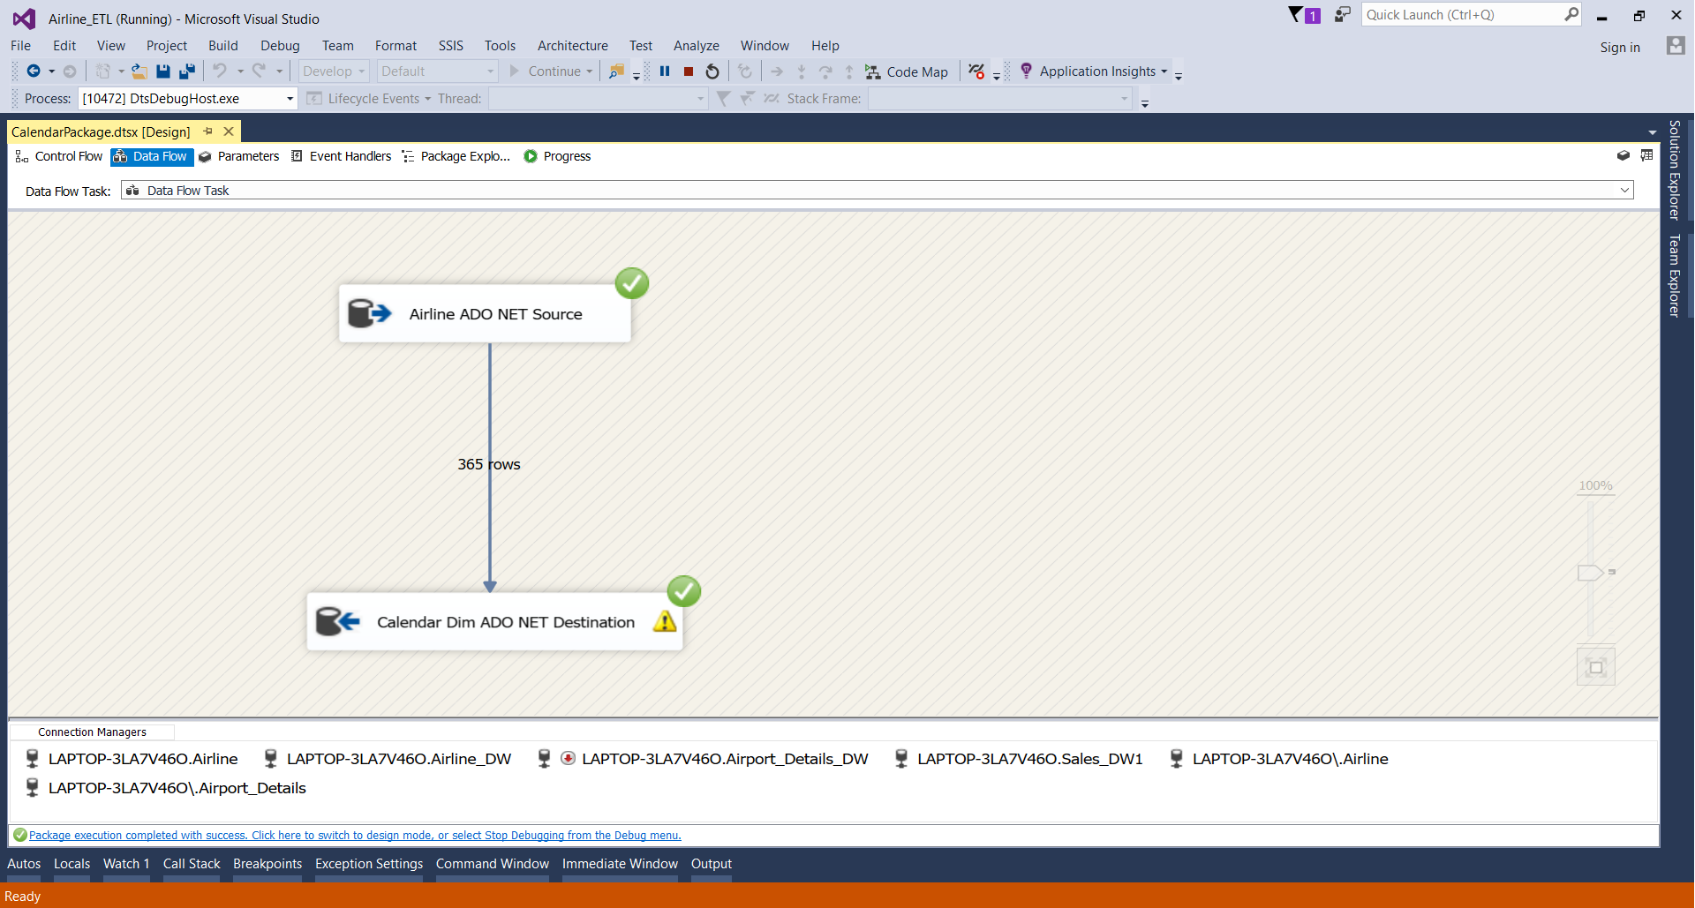
Calendar Dimension ETL Diagram

Slide 13
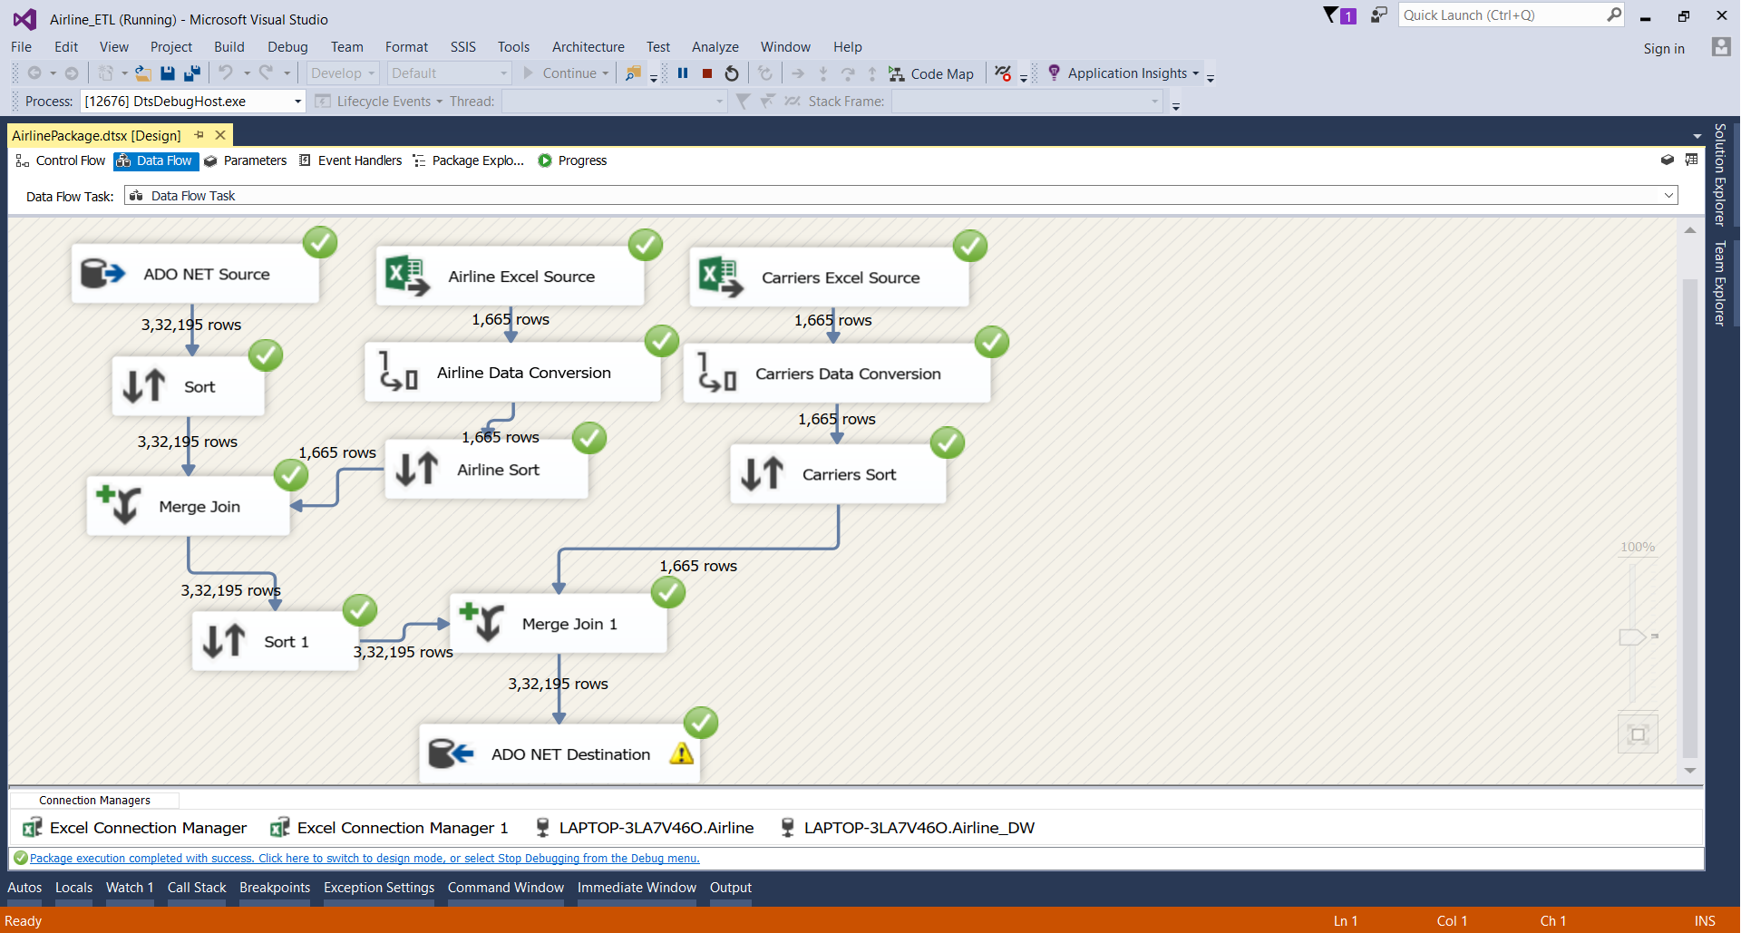
Airline Dimension ETL Diagram

Slide 14
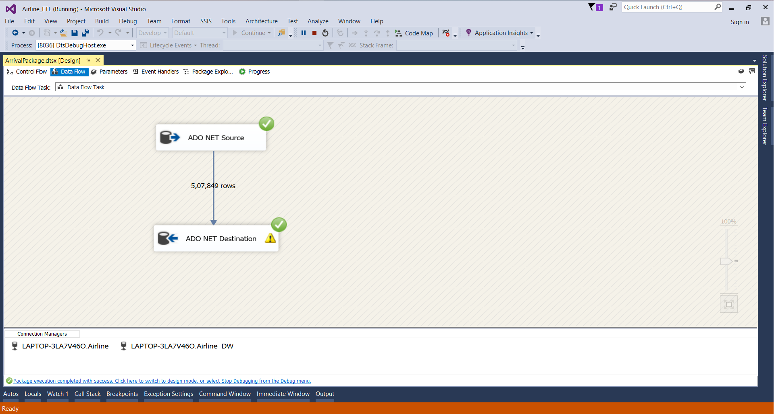
Arrival Dimension ETL Diagram

Slide 15

Departure Dimension ETL Diagram

Slide 16
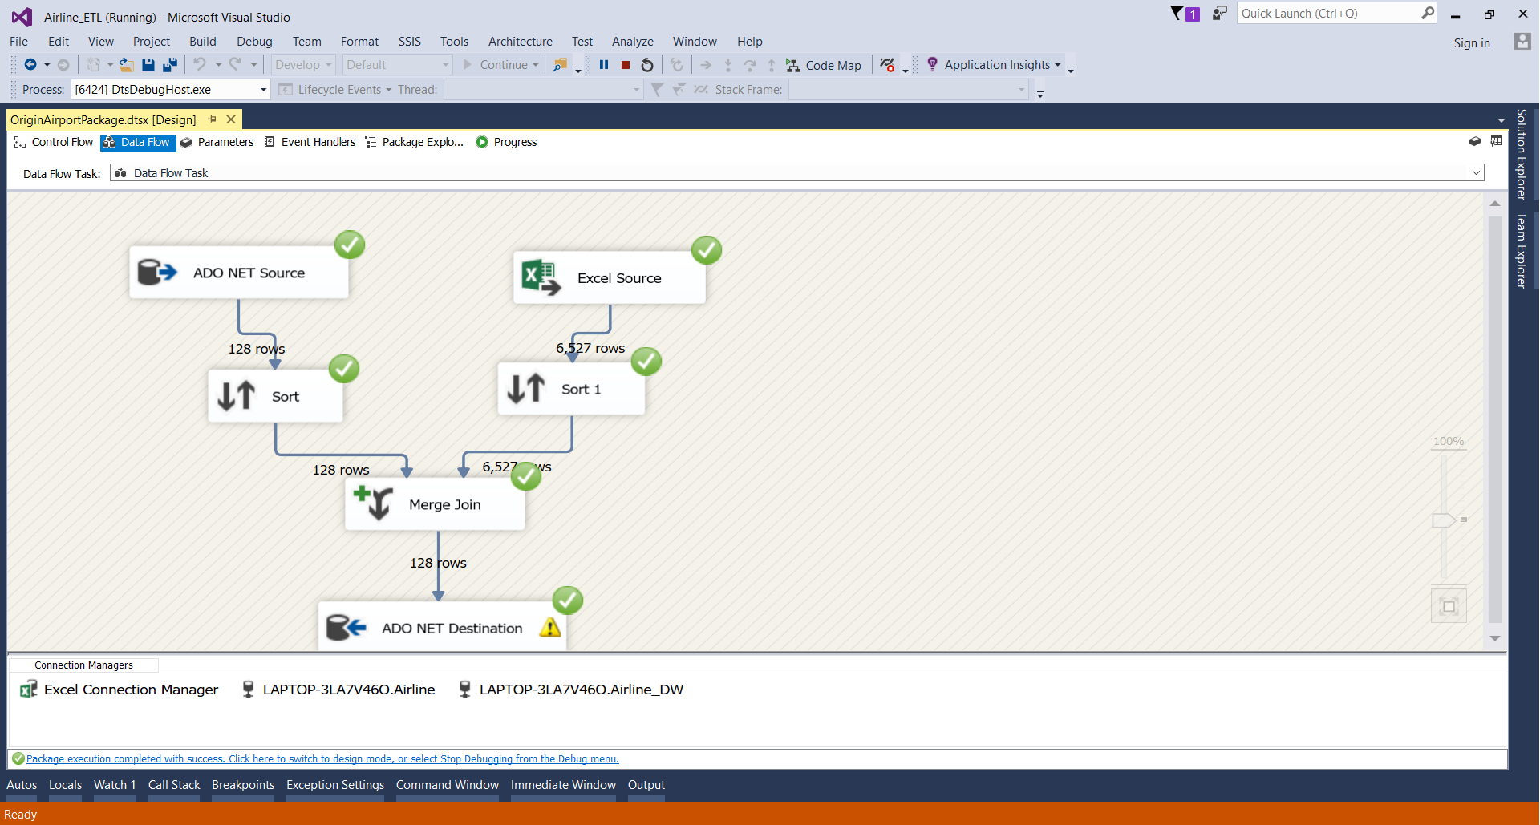
Origin Airport Dimension ETL Diagram

Slide 17
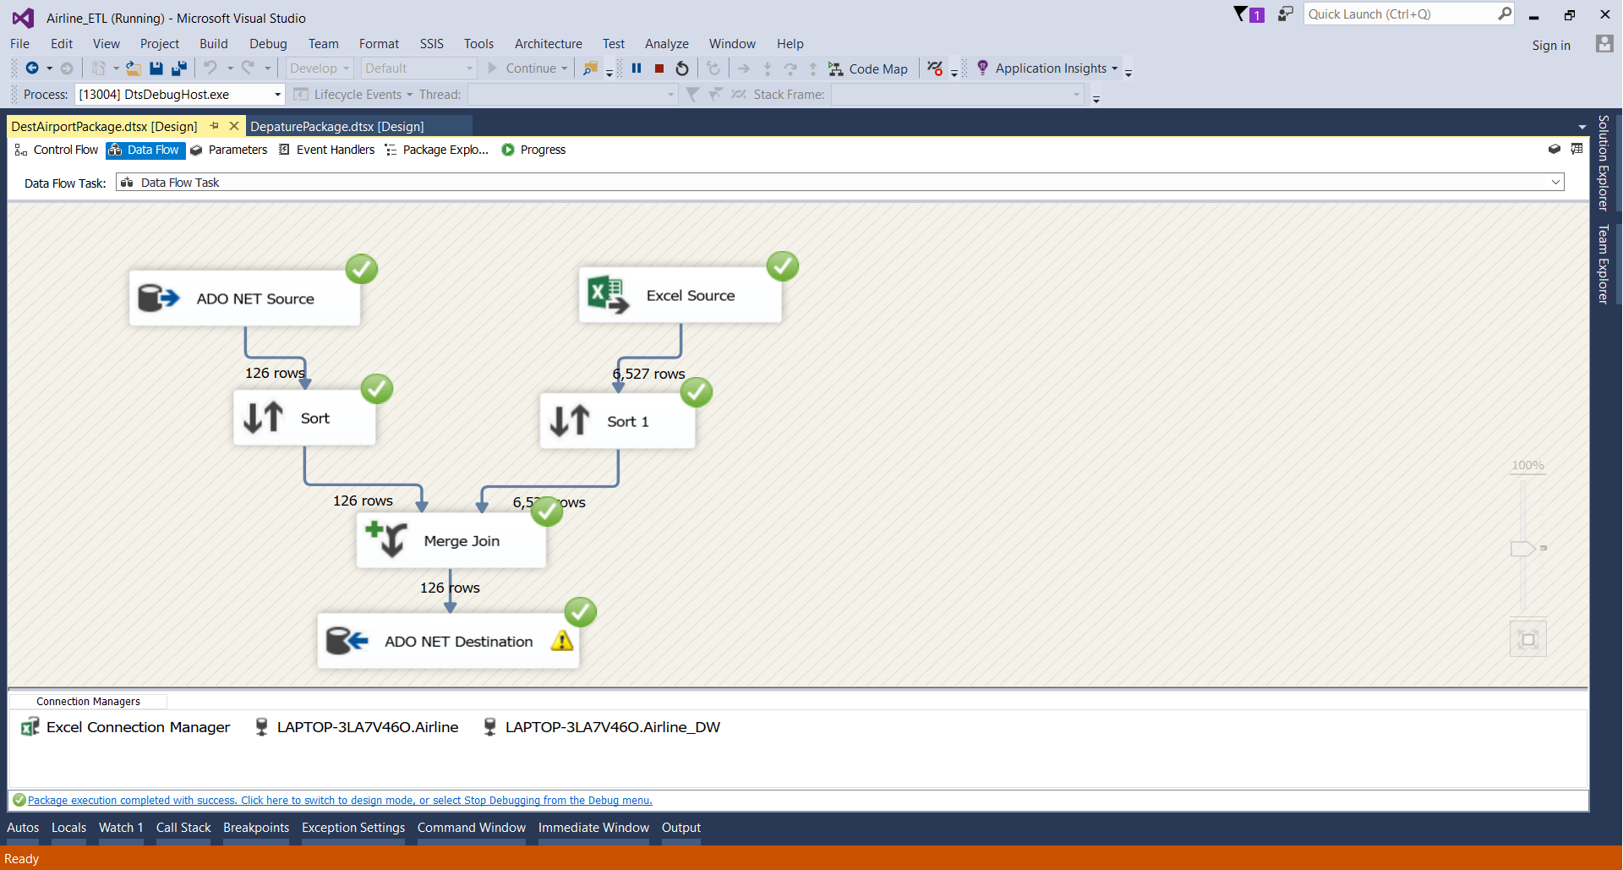
Destination Airport Dimension ETL Diagram

Slide 18
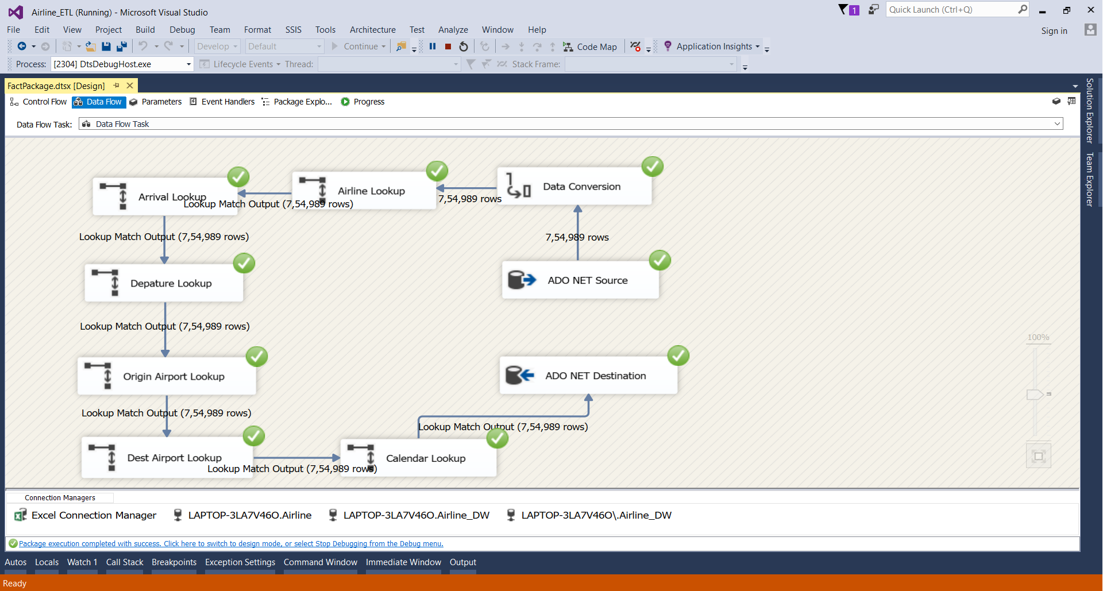
FACT TABLE ETL Diagram

Slide 19
Visualizations
We made visualization using 2 tools:
R – Plotted the various graphs
SSRS – Created the reports for comparing different parameters causing the delay.

Slide 20
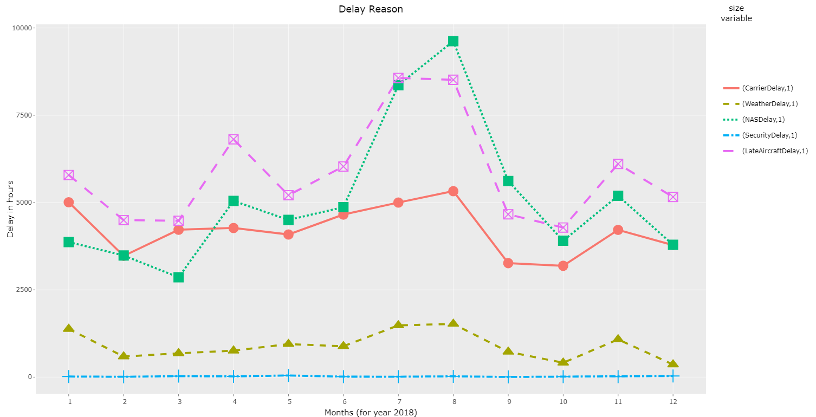
Line Graph for Delay Reason in flights during 2018

Slide 21
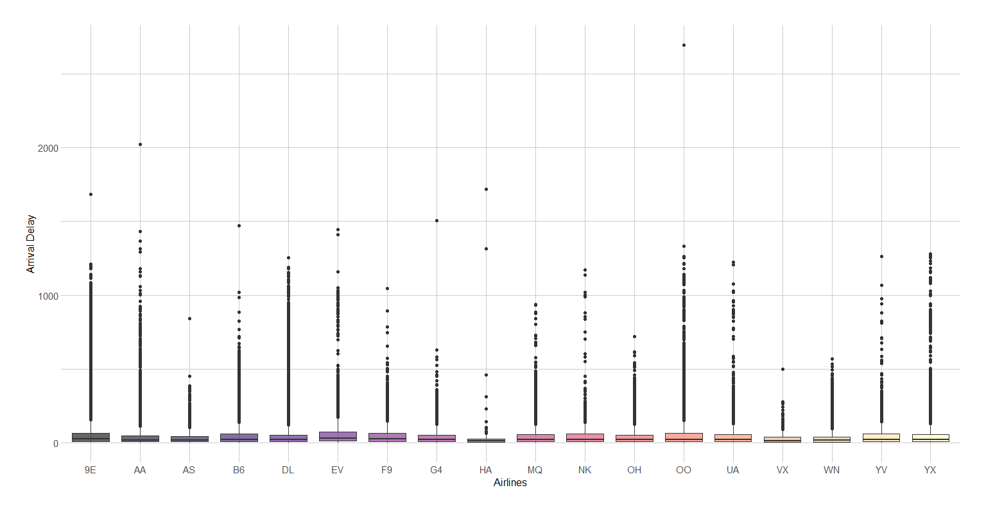
Box Plot of Arrival Delay

Slide 22
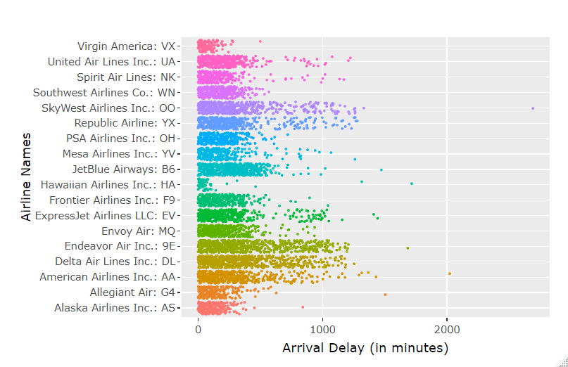
Jitter Plot of Arrival Delay for Different Flights

Slide 23
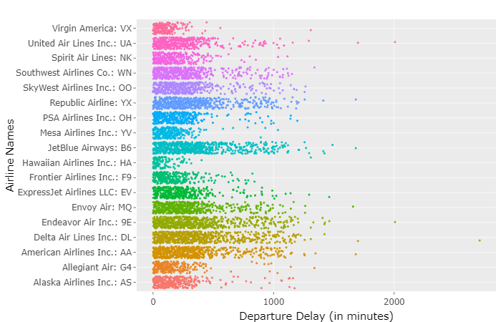
Jitter Plot of Departure Delay for Different Flights

Slide 24
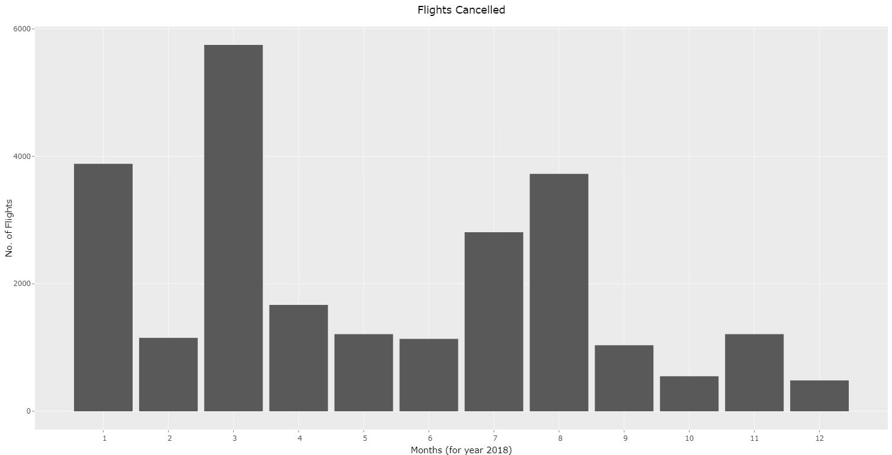
Bar Graph for Flights cancelled in 2018

Slide 25
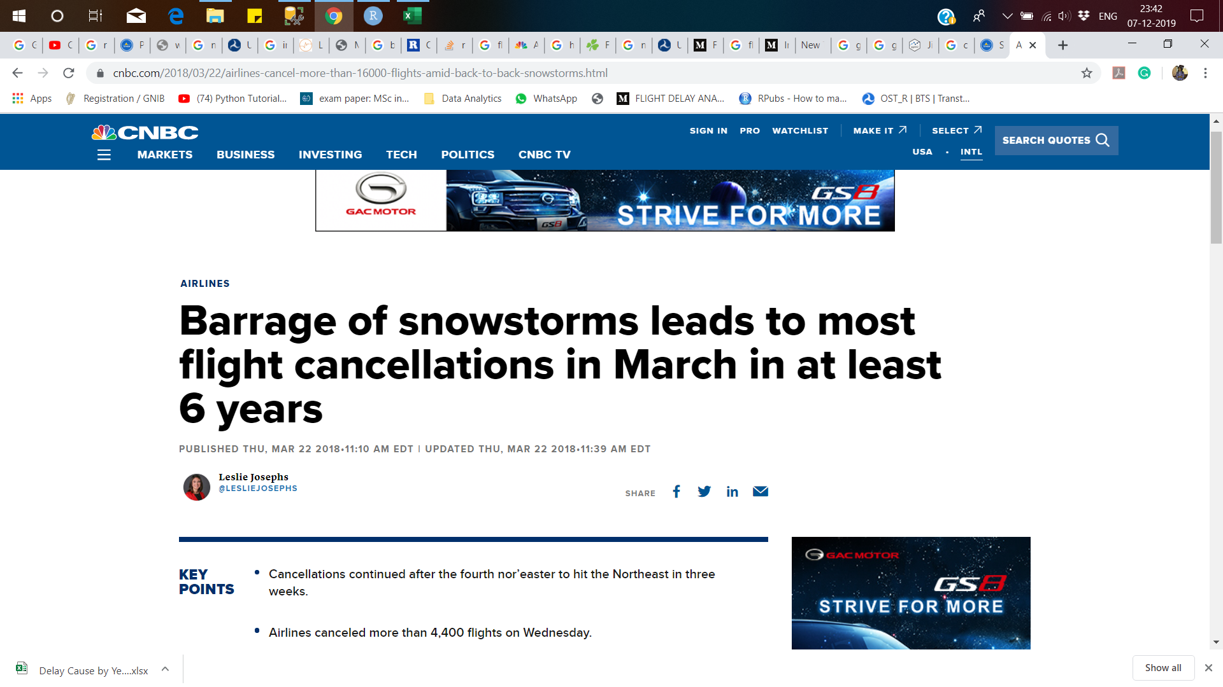
Flights cancelled in March 2018

Slide 26
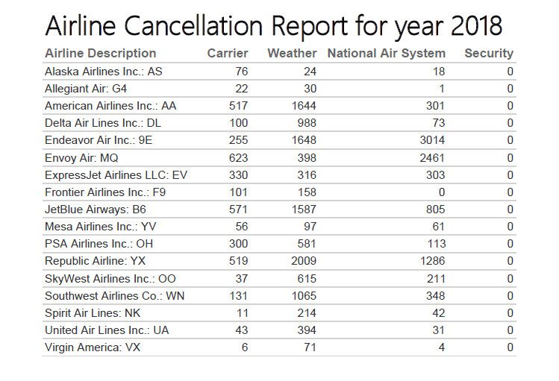
Reports using SSRS

Slide 27
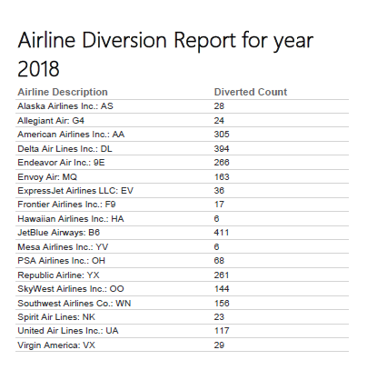
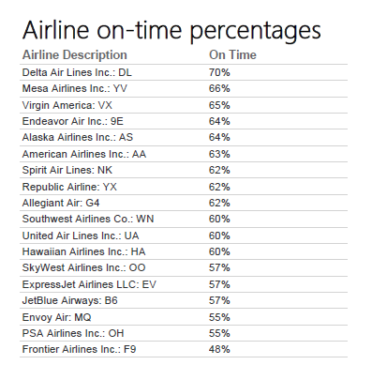

Slide 29
XML and Schema

Slide 30
XML
XML is a markup language designed for data storage.
We can create our own markup elements for generating customized markup language.
XML focuses on data transfer.
XML Schema
XML Schema defines the structure of an XML document.
It is mostly known as XML Schema Definition (XSD).
It is exactly like a database schema which describes about the data.

Slide 31
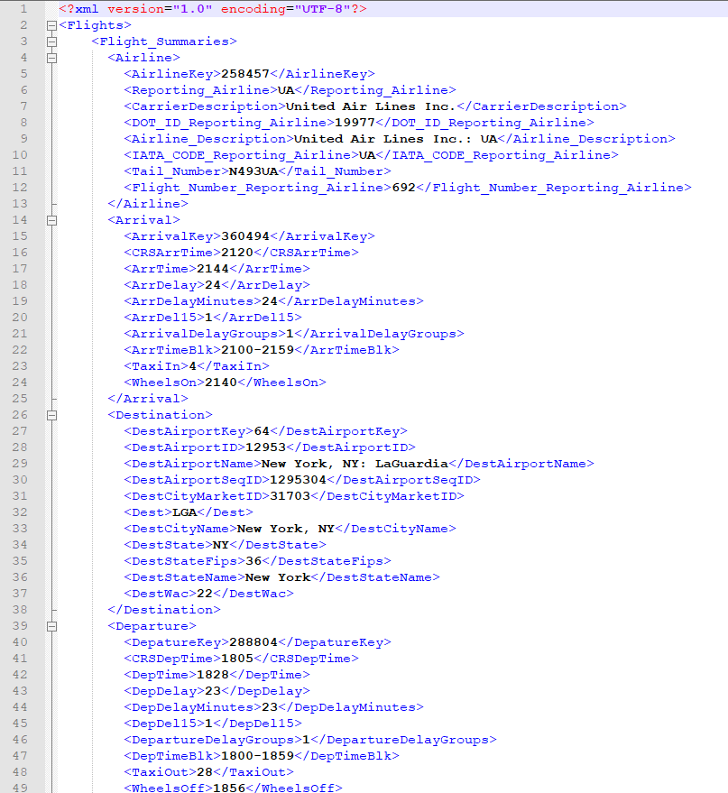
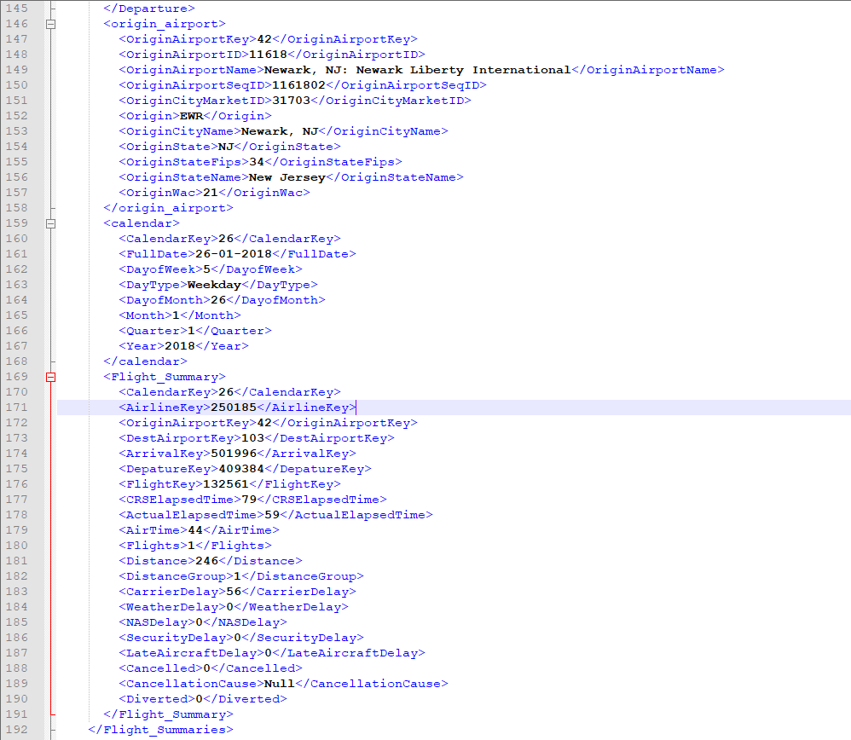

Slide 32
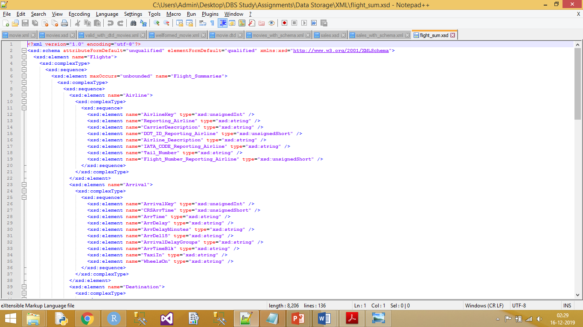

Slide 33
Graph Database

Slide 34
Neo4J
Using Neo4j we were able to represent data in a more graphical and interactive way.
The other advantage of Graph database is that it handles scattered data much more user friendly than the relational database.
As compared to relational databases graph databases consider relationships as separate objects which help in achieving good performance and this increases the readability of the model.
The below Graph describes the warehouse design of the dataset. We tried to explain various flights taking off from New York to different locations across the US as well as arriving to New York in the month of January. The graphical form of the data makes it easy to know the relationship between various data points easier.

Slide 35
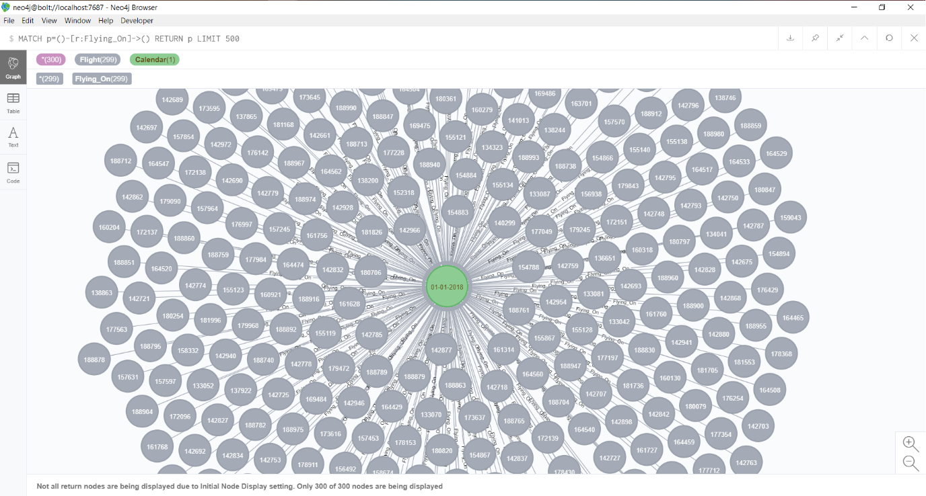
Graph for flights on a Single day

Slide 36
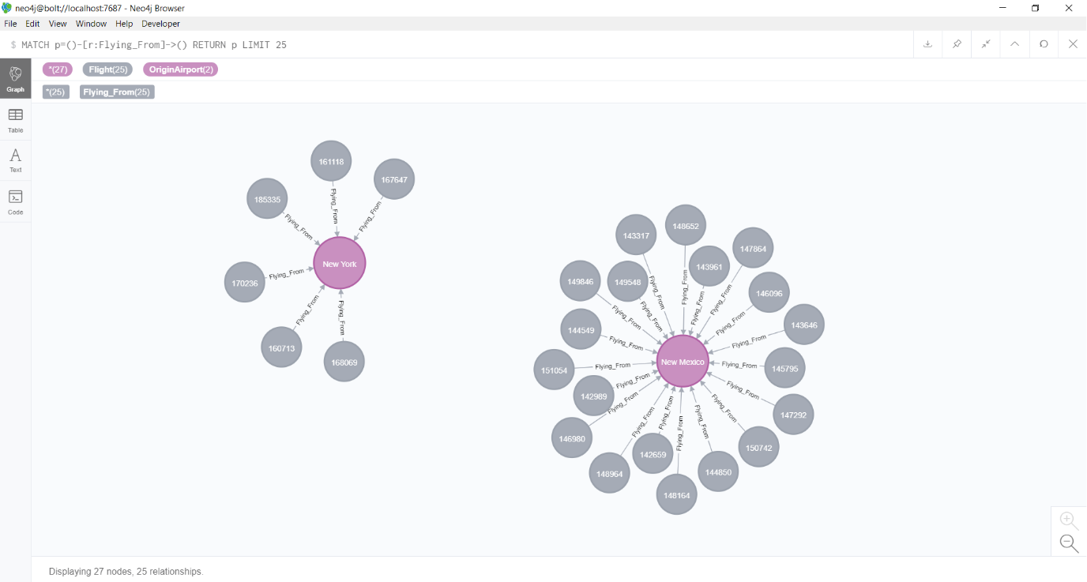
Graph for Flights flying from Airports

Slide 37
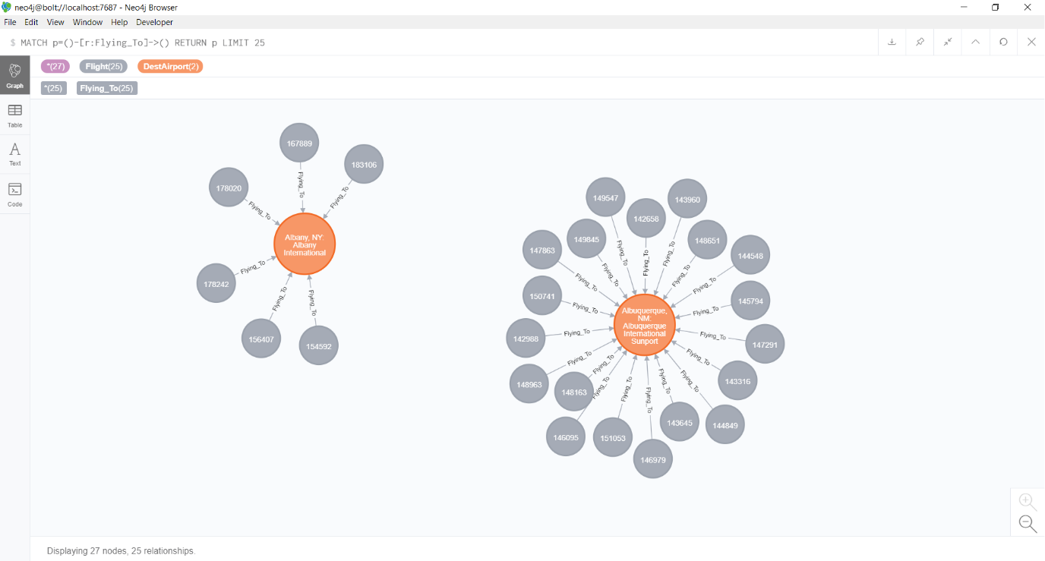
Graph for Flights flying to Airports

Slide 38
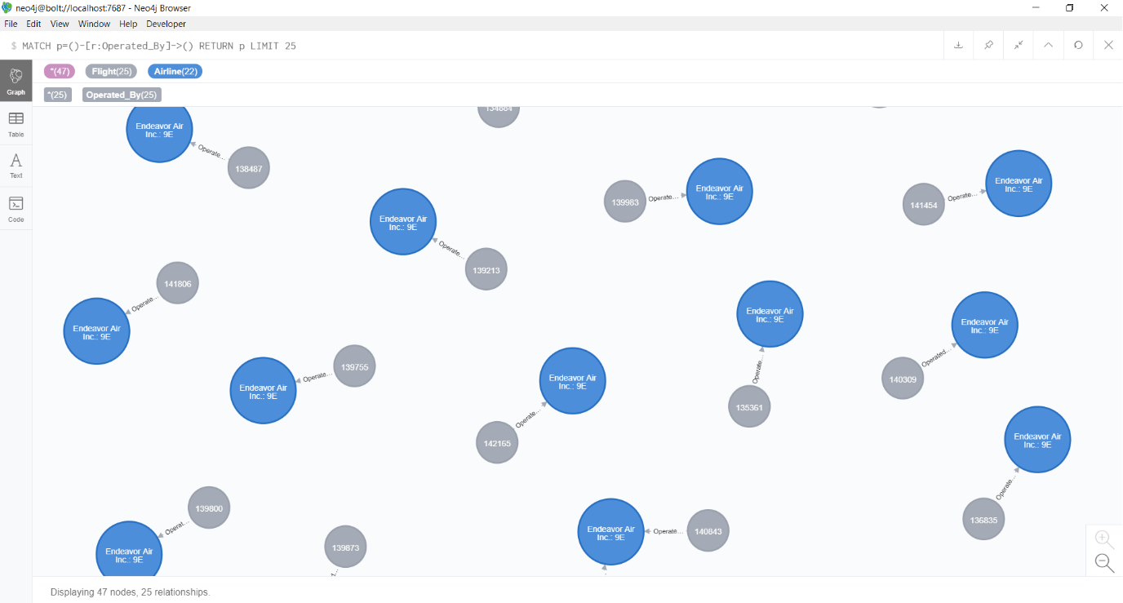
Graph for Flights operated by

Slide 39
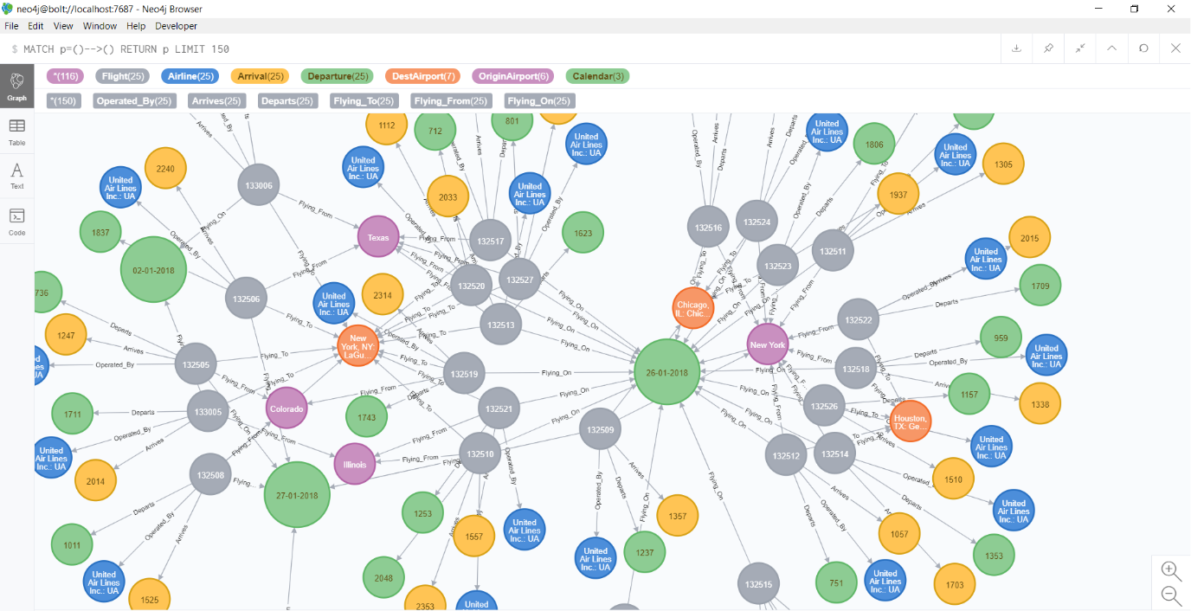
Warehouse GRAPH (VISUALIZATION USING NEO4J)

Slide 40
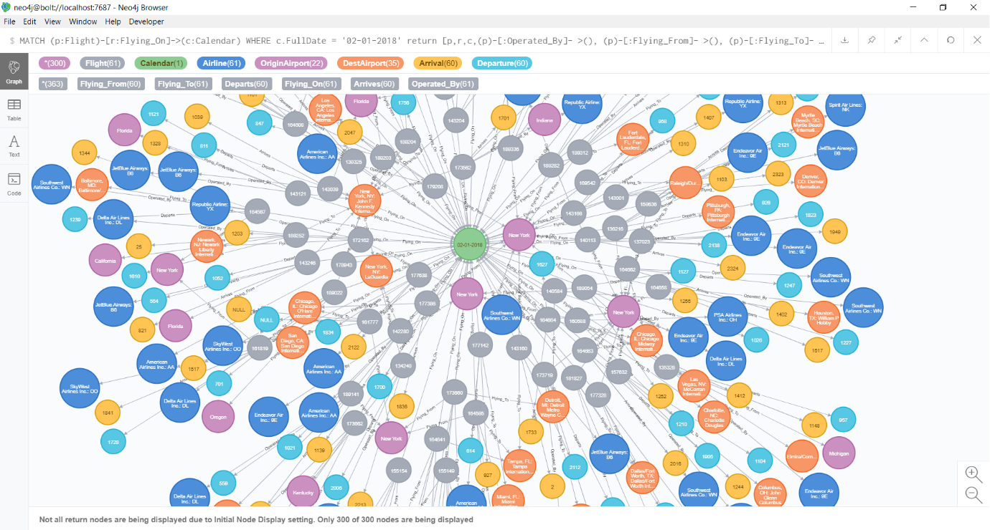
Warehouse Design for flights for a single day

Slide 41
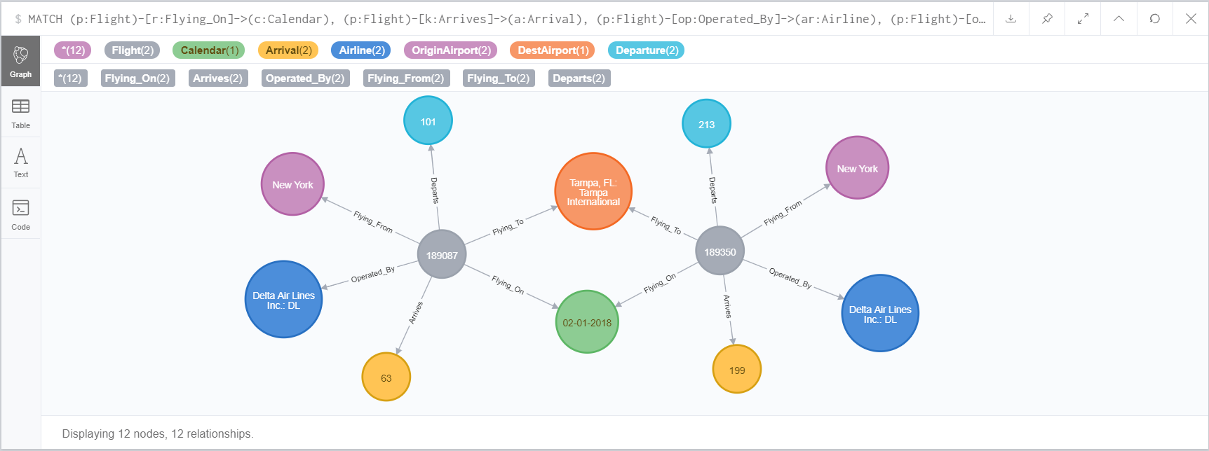
Individual Node Graph

Slide 42
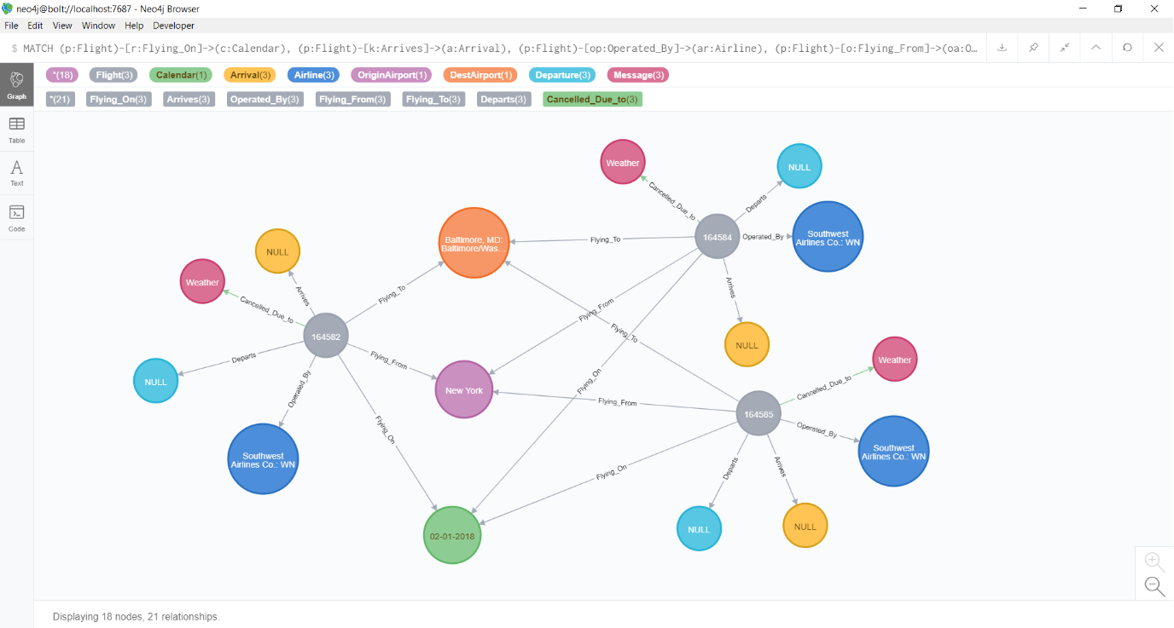
Graph for Flights Cancelled Cause

Slide 43
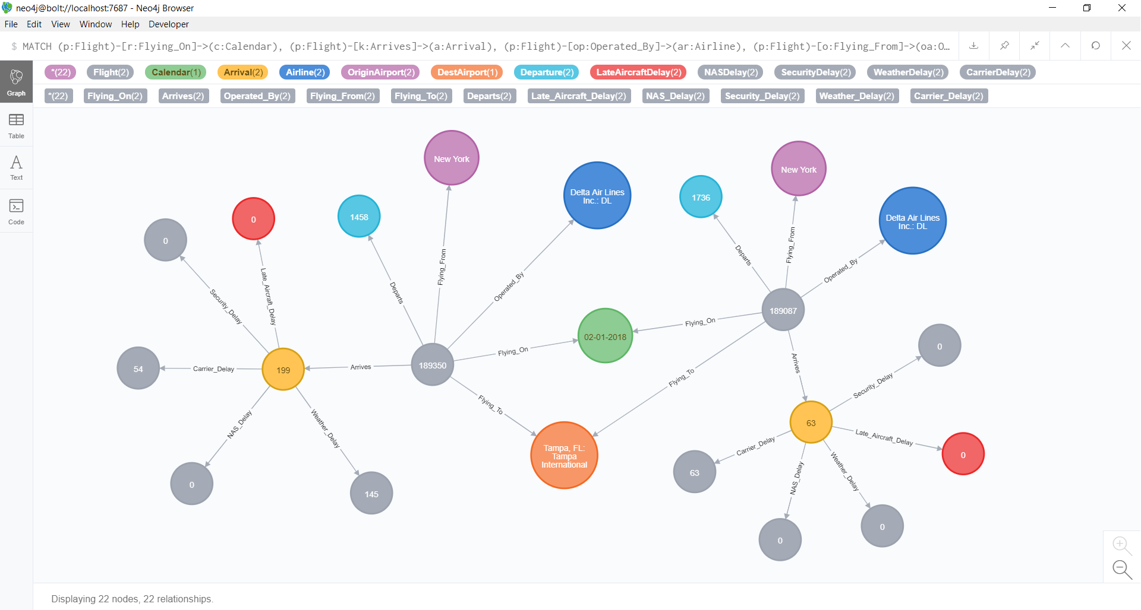
Graph for flights delayed Cause

Slide 44
Conclusion
We were able to identify that the delay in the flights is taking place because of the different delay causes. This also lead to cancellation and diversion of Flights.

Slide 45
Thank You!!!

